Slide 1


Hii,
Iam Siddhika
Welcome to Power BI Series
Part -59

Slide 2



I’m very excited to dive into this with you all!
Are you ready to enhance your data visualization skills?
We focus only on the most used and important Visuals
Today Content
VISUALIZING DATA
VISUALS - SHOWING SINGLE METRIC
CARD VISUAL MULTI-ROW CARD

Slide 3
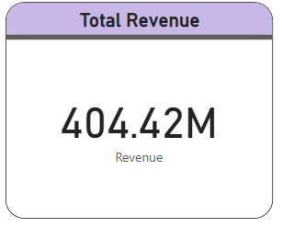


CARD VISUAL
Go and
explore
A Card visual in Power BI displays a single value from your data. It’s a simple, straightforward visual that highlights an important metric.
formating of
Card Visual
Purpose: The purpose of a Card visual is to draw attention to a specific number, making it easy for viewers to quickly grasp important information without any distraction.
When to Use: Use a Card visual when you need to showcase a single key metric or
value. This is particularly useful for displaying totals, averages, highest or lowest values, or other significant figures that need to stand out.

Slide 4
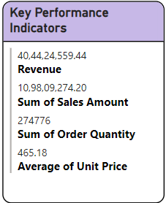


MULTI-ROW CARD
Go and explore formating of Multi - row Card Visual
A Multi-Row Card visual in Power BI displays multiple single values in a card format. Each card shows a summary of data for different fields or measures, providing a compact and organized view of key metrics.
Purpose: The purpose of a Multi-Row Card visual is to provide a concise and easily readable summary of multiple
When to Use: Use a Multi-Row Card visual when you want to present several key performance indicators
data points. It helps in quickly comparing different metrics without the need for separate visuals for each measure.
(KPIs) in a single visual. This is especially useful for dashboards where space is limited, but multiple important metrics need to be displayed together.

Slide 5


Thank you for joining me today to learn about Part -59 of Power BI!
Remember, Effective data visualization is crucial for turning data into meaningful insights and compelling narratives with Power BI.
Stay tuned for more insights and tips on Power BI in our next Series.
Follow
Siddhika Shah

